Slide 1
Major Histocompatibility Complex

Slide 2
Learning Objectives
Definitions (tissue compatibility/incompatibility, haplotypes, polymorphism, codominance)
MHC genes/proteins (Class I,II, and III)
MHC structure (Class I & II)
Ag recognition (Intracellular by MHC class I Vs extracellular antigens by MHC class II
MHC functions and restriction (ref;T-cells)
Medical applications e.g paternity tests etc

Slide 3
MHC
Major Histocompatibility Complex
  Cluster of genes found in all mammals
  Its products play role in discriminating self/non-self
  Participant in both humoral and cell-mediated immunity
MHC Act As Antigen Presenting Structures
In Human MHC Is Found On Chromosome 6
  Referred to as HLA complex
In Mice MHC Is Found On Chromosome 17
  Referred to as H-2 complex

Slide 4
MHC
Genes Of MHC Organized In 3 Classes
  Class I MHC genes
    Glycoproteins expressed on all nucleated cells
    Major function to present processed Ags to T_{C}
  Class II MHC genes
    Glycoproteins expressed on MΦ, B-cells, DCs
    Major function to present processed Ags to T_{H}
  Class III MHC genes
    Products that include secreted proteins that have immune functions. Ex. Complement system, inflammatory molecules

Slide 5
Class I, II and III MHC
Class I MHC Genes Found In Regions A, B and C In Humans (K and D In Mice)
Class II MHC Genes Found In Regions DR, DP and DQ (IA and IE In Mice)
Class I and Class II MHC Share Structural Features
  Both involved in APC
Class III MHC Have No Structural Similarity To Class I and II
  Ex. TNF, heat shock proteins, complement components

Slide 6
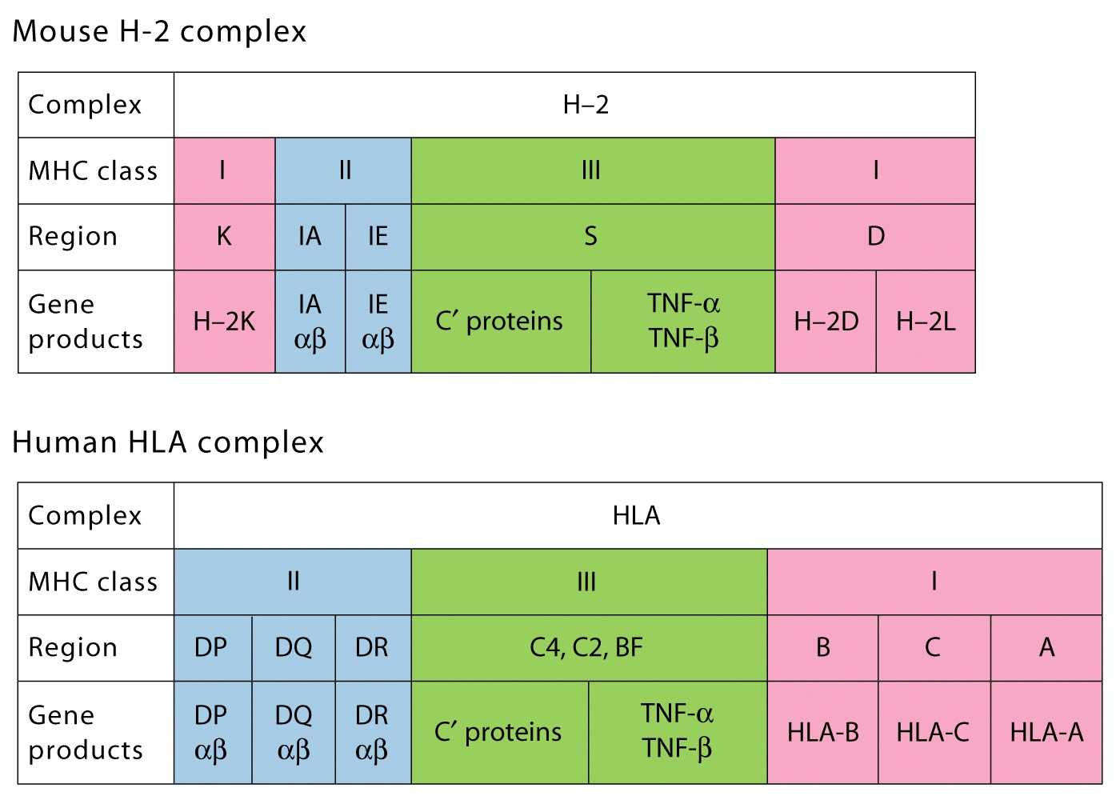

Slide 7
MHC Genes Are Polymorphic
MHC Products Are Highly Polymorphic
  Vary considerably from person to person
However, Crossover Rate Is Low
  0.5% crossover rate
  Inherited as 2 sets (one from father, one from mother)
  Haplotype refers to set from mother or father
MHC Alleles Are Co-dominantly Expressed
  Both mother and father alleles are expressed
Inbred Mice Haplotypes Are Designated With Italic Superscript
  Ex. H-2^{b}
  Designation refers to entire set of H-2 alleles

Slide 8
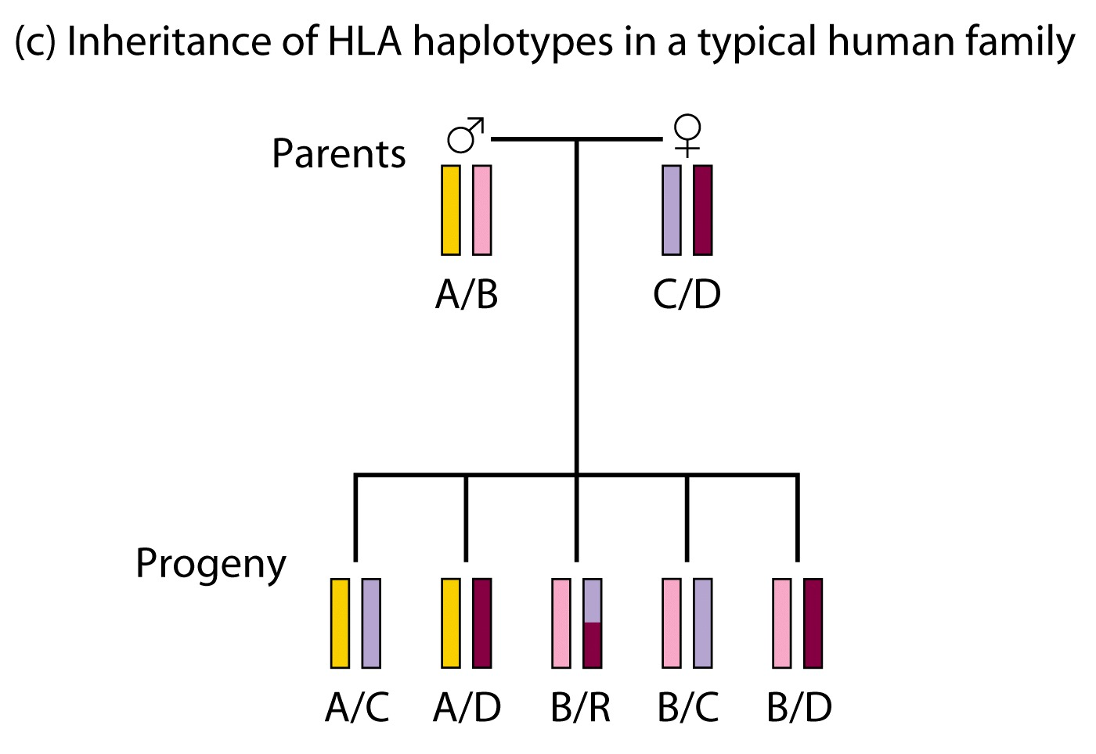
Inheritance Of HLA Haplotypes

Slide 9
Class I MHC Molecule
Comprised of 2 molecules
  α chain (44 kDa), transmembrane polypeptide
  β₂-microglobulin (12 kDa)
  Non-covalently associated with each other
Association Of α Chain and β₂ Is Required For Surface Expression
α Chain Made Up Of 3 Domains (α1, α2 and α3)
β₂-microglobulin Similar To α3
α1 And α2 Form Peptide Binding Cleft (groove)
  Fits peptide of about 8-10 a/a long
α3 Highly Conserved Among MHC I Molecules
  Interacts with CD8 (T_{C}) molecule

Slide 10
Class II MHC Molecule
Comprised of α and β chains
  α chain and β chain associate non-covalently
α and β chains Made Up Of Domains
  α1 and α2 (α chain)
  β1 and β2 (β chain)
α1and β1 Form Antigen Binding Cleft
α and β Heterodimer Has Been Shown To Dimerize
CD4 Molecule Binds α2/β2 domains

Slide 11
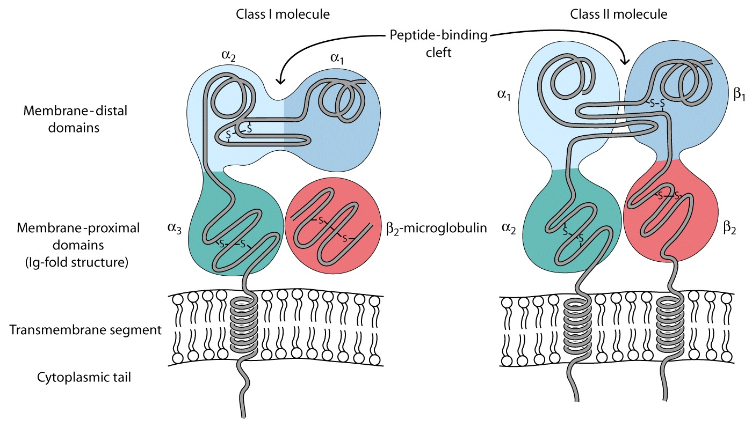

Slide 12
Class I And II Specificity
Several Hundred Allelic Variants Have Been Identified In Humans
However, up to 6 MHC I And 12 MHC II Molecules Are Expressed In An Individual
Enormous Number Of Peptides Needs To Be Presented Using These MHC Molecules
To Achieve This Task MHC Molecules Are Not Very Specific For Peptides (Unlike TCR and BCR)
Promiscuous Binding Occurs
  A peptide can bind a number of MHC
  An MHC molecule can bind numerous peptides

Slide 13
Class I And II Diversity And Polymorphism
MHC Is One Of The Most Polymorphic Complexes Known
Alleles Can Differ Up To 20 a/a
Class I Alleles In Humans: 240 A, 470 B, 110 C
Class II Alleles In Humans: HLA-DR 350 β, 2 α!
HLA-DR
  β genes vary from 2-9 in different individuals!!!,
  1 α gene (α can combine with all β products increasing number of APC molecules)
DP (2 α, 2 β) and DQ (2 α, 3 β)

Slide 14
Class I MHC Peptides
Peptides Presented Thru MHC I Are Endogenous Proteins
As Few As 100 Peptide/MHC Complex Can Activate T_{C}
Peptide Features
  size 8-10 a/a, preferably 9
Peptides Bind MHC Due To Presence Of Specific a/a Found At The Ends Of Peptide. Ex. Glycine @ Position 2

Slide 15
Class II MHC Peptides
Peptides Presented Thru MHC II Are Exogenous
  Processed thru endocytic pathway
Peptides Are Presented To T_{H}
Peptides Are 13-18 a/a Long
Binding Is Due To Central 13 a/a
Longer Peptides Can Still Bind MHC II
  Like A long hot dog
MHC I Peptides Fit Exactly, Not The Case With MHC II Peptides

Slide 16
MHC Expression
Expression Is Regulated By Many Cytokines
  IFNα, IFNβ, IFNγ and TNF Increase MHC expression
Transcription Factors That Increase MHC gene Expression
  CIITA (Transactivator), RFX (Transactivator)
Some Viruses Decrease MHC Expression
  CMV, HBV, Ad12
Reduction Of MHC May Allow For Immune System Evasion

Slide 17
Reference Text Books (See latest versions)
1. Roitt’s essential immunology 12 edition
2. Cellular and molecular immunology, by Abul Abbas, Andrew Lichtman, and Jordan Pobe
3. Immunobiology - the immune system in health and disease, by Charles Janeway, Jr. and Paul Travers
4. Kuby immunology
5. Basic Immunology by Abdul K. Abbas and Andrew H. Lichtman S.

Slide 18

Thank You

